Slide 1
Biometric Signature ID
Guidelines and instructions on how to deploy and use the BioSight-ID™ Exam Monitoring feature for BioSig-ID™ quiz-intercepts within Blackboard.

Slide 2
Configuring BioSight-ID™ Admin
BioSight-ID™ can be configured multiple ways, some of which are:
Every BioSig-ID™ quiz-intercept automatically activates BioSight-ID™ for every course across the entire institution.
Configuration option that the Biometric Signature ID (BSI) staff activates (as was done last week).
Only specific Blackboard courses identified via Blackboard course-labels will have BioSight-ID™ active on their BioSig-ID™ quiz-intercepts.
CTCD admins provide a list to BSI staff containing all the Blackboard course labels for the semester.
The BioSight-ID™ feature is only activated or deactivated when the Blackboard course test-assessment title matches a certain syntax.
Instructors are in full control of this feature by modifying the test-assessment title. This could be done with BioSight-ID™ active or inactive (this is better choice) by default.
Except for 3rd option no action is required by the instructor to turn on the BioSight-ID™ feature for their course.

Slide 3
BioSight-ID™ Experience Student
The BioSight-ID™ Student experience is self-explanatory and guides the student through the process.
It does help to explain this new requirement to the student within their Blackboard course, which is covered on the next slide.
Having a policy to cover students who cannot afford a webcam is useful.

Slide 4
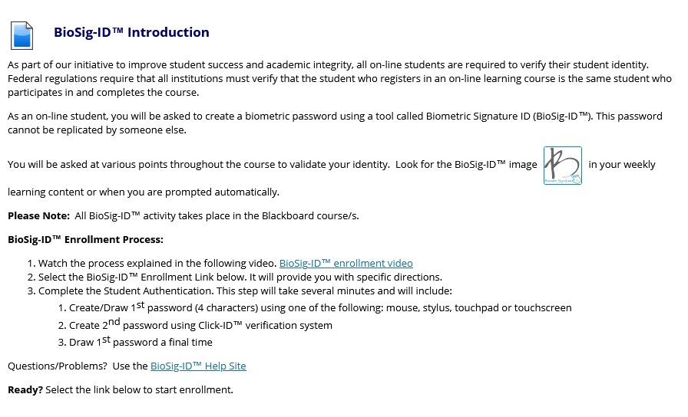
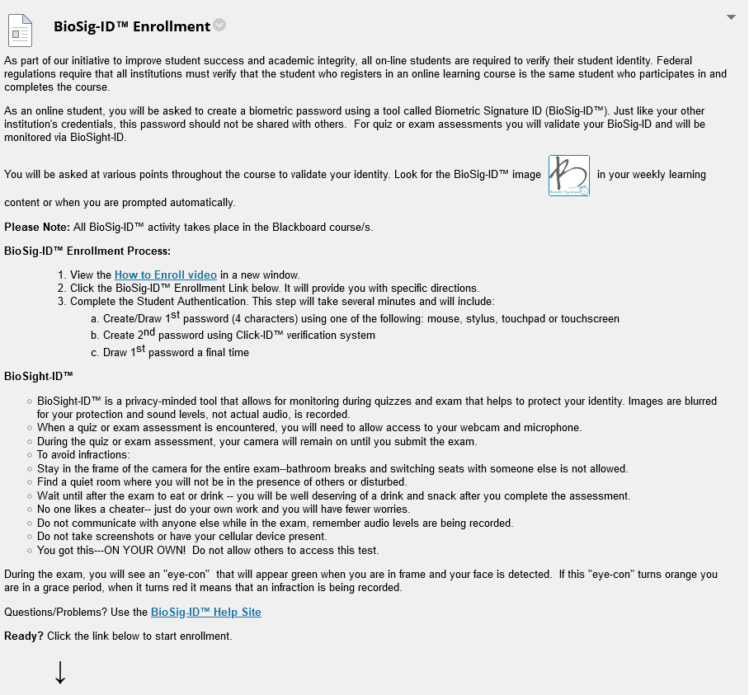
BioSig-ID™ Introduction Admin/Instructor
The HTML code-block to use for copy-n-pasting the updated instructions
on the “BioSig-ID™ + BioSight-ID™” enrollment course item are available at:
https://setup.biosig-id.com/portal/en/kb/articles/blackboard-learn-enrollment-introduction
OLD/EXISTING
NEW/UPDATED

Slide 5
BioSight-ID™ Dashboard Admin/Instructor
The BioSight-ID™ Dashboard is available to instructors inside the “Course Tools” menu.
It provides access to review the video recordings for the students within the course.
This video gives a brief insight on how to filter down and review suspicious activity.
NOTE: Certain links in the BioSight-ID™ Dashboard might require a higher-level of access. So, instructors require admin to exempt a student.

Slide 6
BioSig-ID™ Support All
Additional info on the end-user experience is available at (support tickets can be submitted here):
https://help.biosig-id.com/
Instructors can find more technical info at:
https://setup.biosig-id.com/

